Slide 1
BASICS OF RADIOPHARMACY
Dr Elizabeth Itotia
Radiopharmacist, KUTRRH

Slide 2
Learning objectives
What is a radiopharmacy?
What are radiopharmaceuticals? Examples?
Methods of production of radiopharmaceuticals
Application of radiopharmaceuticals
Radiation protection in the radiopharmacy
Limits of radiation exposure
Differences between spect radiopharmacy and pet radiopharmacy
Quality control and quality assurance in the radiopharmacy

Slide 3
What is a Radiopharmacy?
A radiopharmacy is a place where radioactive drugs are prepared and dispensed. These radioactive drugs are referred to as radiopharmaceuticals.
It also acts as a depot for the storage of radioactive materials and radioactive waste.
A Radiopharmacy is part of the nuclear medicine section in a hospital

Slide 4
RADIOPHARMACEUTICALS
Drugs containing one or more radioactive components
2 components:
A RADIONUCLIDE that provides the desired radiation characteristics
A CHEMICAL COMPOUND with structural or chemical properties that determine the in vivo distribution and physiological behaviour of the radiopharmaceutical

Slide 5
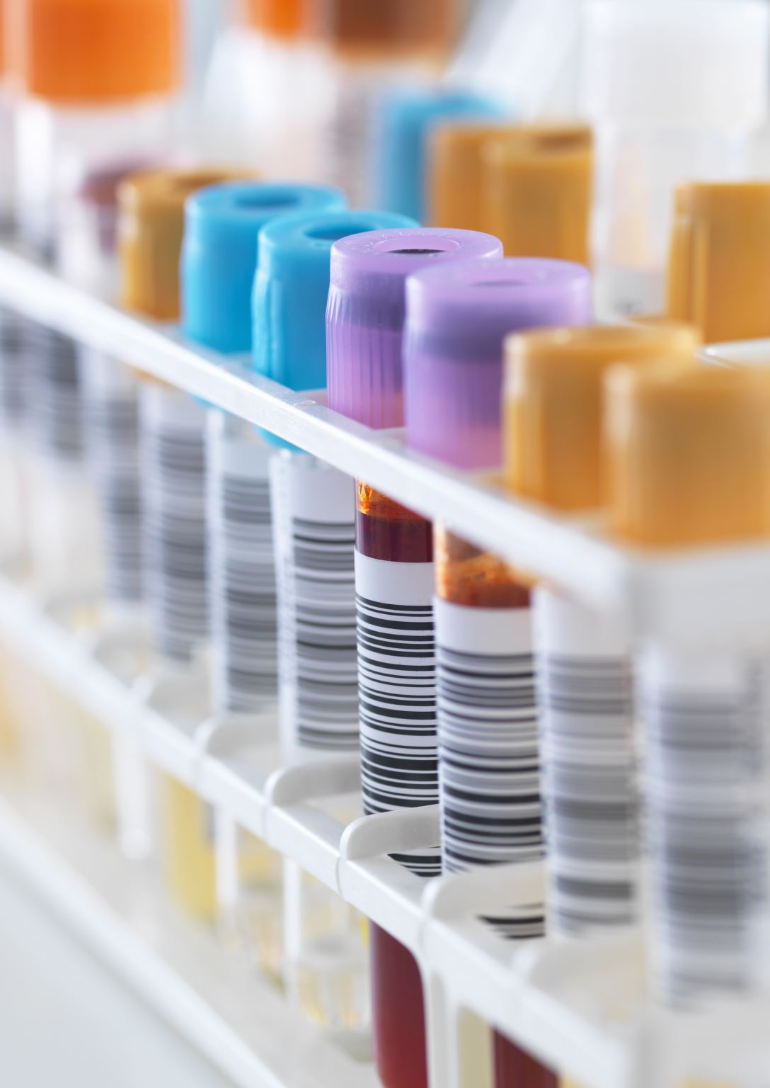
RADIOPHARMACEUTICALS
Example: ¹⁸F-FDG. ¹⁸F is the radionuclide and FDG is the chemical compound otherwise referred to as the ligand
The radioisotope is bound to the ligand, thus being dragged to the target organ
They normally have no pharmacologic effect, as they are used in tracer quantities

Slide 6
RADIOPHARMACEUTICALS
Radiopharmaceuticals require much more handling immediately before administration to the patient when compared to other drugs.
Majority are characterised by extremely short half life, warranting production at the same site they will be used shortly before use
All quality control procedures applied to other pharmaceutical drugs are also applied to radiopharmaceuticals.
In addition radiopharmaceuticals are subjected to other tests such as radio-nuclidic or radiochemical purity

Slide 7
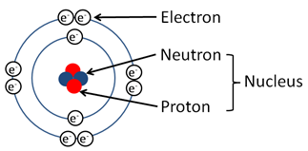
What is a radionuclide?
Remember the structure of an atom?
Stable, unstable
Radionuclide: Unstable nuclei that are stabilized upon radioactive decay.
Decay modes: a radionuclide may decay by emitting different types of ionising radiation: alpha particle, β+ particle, β- particle and gamma rays
Decay mode of a radionuclide determines the imaging modality used and the therapeutic indication.

Slide 8
IMAGING MODALITIES
PET: Positron emission tomography
SPECT: Single photon emission computed tomography
PET: The radioactive isotope decays by emitting a positron
SPECT: The radioactive isotope decays by emitting a gamma ray
Different imaging modalities therefore require different radiopharmaceuticals, prepared in different sections of a radio pharmacy
Therefore:
PET Radiopharmacy
SPECT Radiopharmacy

Slide 9
EXAMPLES
^{99m}Tc decays by emitting a gamma ray to ⁹⁹Tc. When a patient is injected with ^{99m}Tc, SPECT is used for imaging
¹⁸F-FDG decays by emitting a positron to ¹⁸O. When a patient receives ¹⁸F-FDG, PET is used for imaging
^{99m}Tc is prepared in a SPECT radiopharmacy while ¹⁸F-FDG is prepared in a PET radiopharmacy. The two cannot be prepared in the same space due to different energies therefore different shielding requirements
Depending on the decay characteristics of the radionuclide, the radiopharmaceutical is used either for diagnosis or therapy
Diagnostic radiopharmaceuticals decay by gamma emission or β+ emission whereas therapeutic radiopharmaceuticals decay by β- or α decay

Slide 10
Production of radiopharmaceuticals
Daily operation of a nuclear pharmacy involves;
a)Receipt of radioactive and non-radioactive materials (eg cold kits)
b) Preparation of the radiopharmaceutical
c) Quality control of the radiopharmaceutical
d) Dispensing of the radiopharmaceuticals
e) Radioactive waste disposal and infectious waste disposal

Slide 11
Methods of production of radiopharmaceuticals
There are three main methods for production of radiopharmaceuticals:
Nuclear reactors
Cyclotrons/particle accelerators
Generators

Slide 12
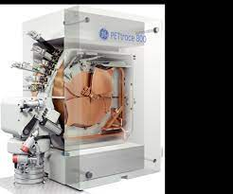
CYCLOTRON

Slide 13
HOT CELL

Slide 14
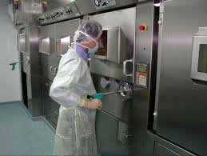
HOT CELL

Slide 15
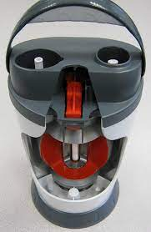
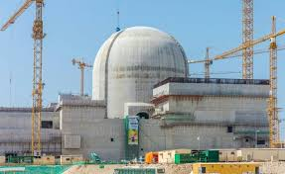
Generator
Nuclear reactor plant

Slide 16
PRODUCTION OF RADIOPHARMACEUTICALS
^{99m}Tc activity is eluted from the generator early each morning. After assaying the activity in a dose calibrator, and perfoming related QC tests, the activity can be used in the labelling of various radiopharmaceuticals
¹⁸F is obtained from the cyclotron. The activity is then pushed to a hot cell where the synthesis and dispensing of bulk and individual doses is done
All subsequent formulation/manipulation is normally done is a LAF and under aseptic conditions. Work is normally done behind lead barriers in the LAF cabinet

Slide 17
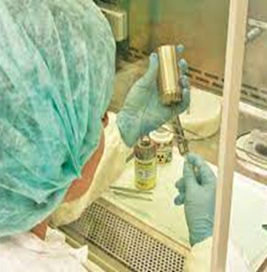
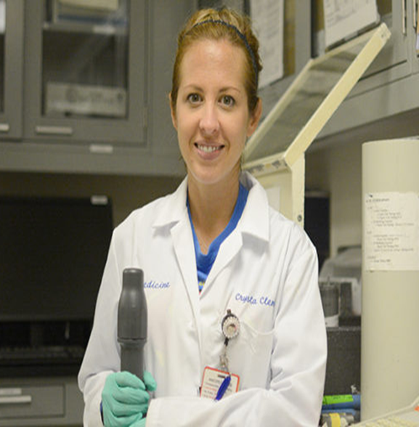
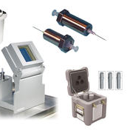
RADIOPHARMACY
Note the: lead shielding for vial syringe
The work station
Pigs
Lead waste container

Slide 18
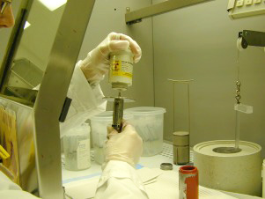
WORKING BEHIND A LEAD SHIELD
RADIOPHARMACY SETUP

Slide 19
Examples of radiopharmaceuticals, application and method of production
Cyclotron produced ¹⁸F-FDG. Used for diagnosis of various types of cancers and following up response to therapy e.g. in colorectal cancer.
Generator produced ^{99m}Tc. When labelled with MDP (99mTc-MDP) is used for skeletal imaging. (diagnosis)
When labelled with MAG3 to ^{99m}Tc-MAG3 is used for renal imaging (diagnosis)
⁹⁹Mo produced from nuclear reactor. Used for the production of ⁹⁹Mo/^{99m}Tc generator

Slide 20
Examples of radiopharmaceuticals, application and method of production
Nuclear reactor produced ¹⁷⁷Lu-PSMA for prostate cancer treatment.
¹⁷⁷Lu-DOTATATE for neuroendocrine tumours treatment.
Nuclear reactor produced ¹³¹I for the treatment of residual thyroid cancer following thyroidectomy, thyroid metastasis and hyperthyroidism.
Cyclotron produced ¹²³I for the diagnosis of thyroid cancers and hyperthyroidism.

Slide 21
QUALITY CONTROL
Each radiopharmaceutical must pass several QC tests before dispensing for human administration. These include the P^{H} test, Labelling efficiency, Sterility and endotoxin test, radiochemical and radionuclidic purity among others
For short lived RP, the sterility and apyrogenicity are conducted after the fact/retrospectively. This means that the radiopharmaceutical is administered while the tests are continued until final results are obtained. If the results are positive, then the subjects are followed up for symptoms for which remedial medications are instituted. An audit on the production method is also done to identify why the product failed.

Slide 22
QUALITY ASSURANCE IN THE RADIOPHARMACY
QA is defined as the totality of arrangements made with the objective of ensuring that pharmaceutical products are of the quality required for their intended use. It incorporates GMP, QC.
QA gives enough confidence that a product or service will satisfy the given requirements for quality

Slide 23
QA in the Radiopharmacy
It is particularly important in the radiopharmacy since most of the products are released without a complete set of quality control owing to the short half life of the radiopharmaceuticals.
Validation of systems and following SOPs to the letter!
QA manager/Authorized person

Slide 24
RADIATION AND RADIOPHARMACEUTICALS
Radiation is an inherent characteristic of all radiopharmaceuticals, and patients normally receive an unavoidable radiation dose. In the case of therapeutic radiopharmaceuticals, radiation is what causes the therapeutic effect.

Slide 25
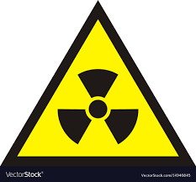
RADIATION PROTECTION!!

Slide 26
WHY DO WE NEED TO PROTECT OURSELVES FROM RADIATION?
OBJECTIVES OF RADIATION PROTECTION
Prevention of deterministic effects (dose related effects)
Limiting the probability of stochastic effects (Non dose related effects)

Slide 27
DETERMINISTIC EFFECTS
Induced by high radiation doses
Severity of damage increases with radiation dose
A threshold value exists below which no effect is seen
E.g. cataracts, skin erythema, sterility.
Radiation doses required to produce such effects occur in radiation accidents.

Slide 28
STOCHASTIC EFFECTS
Stochastic: biological effects that occur randomly
Probability of stochastic effect occurring depends upon radiation dose received, i.e. Probability increases with increasing dose but there is no safe dose
E.g.: radiation-induced hereditary effects and cancer incidences

Slide 29
RADIATION PROTECTION
There are 3 radiation protection principles: justification, optimization and limitation
Justification: All procedures involving radiation materials must be justified
Optimisation: radiation exposure to any individual should be kept as low as reasonably achievable (ALARA)
Limitation: The radiation dose received by personnel handling radioactive material should never exceed the legally established dose limits. (dose to patient is never limited! Limitation applies to members of the public and radiation worker)

Slide 30
DOSE LIMITS
According to the International Commission of Radiation Protection (ICRP), there are three categories of radiation exposure:
Medical exposure
Occupational exposure
Public exposure
No dose limitation for medical exposure of the patient - it is always assumed that the benefits for the patient outweigh the risks.
Dose limits applied for public and occupational exposure

Slide 31
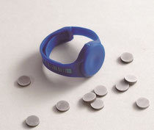
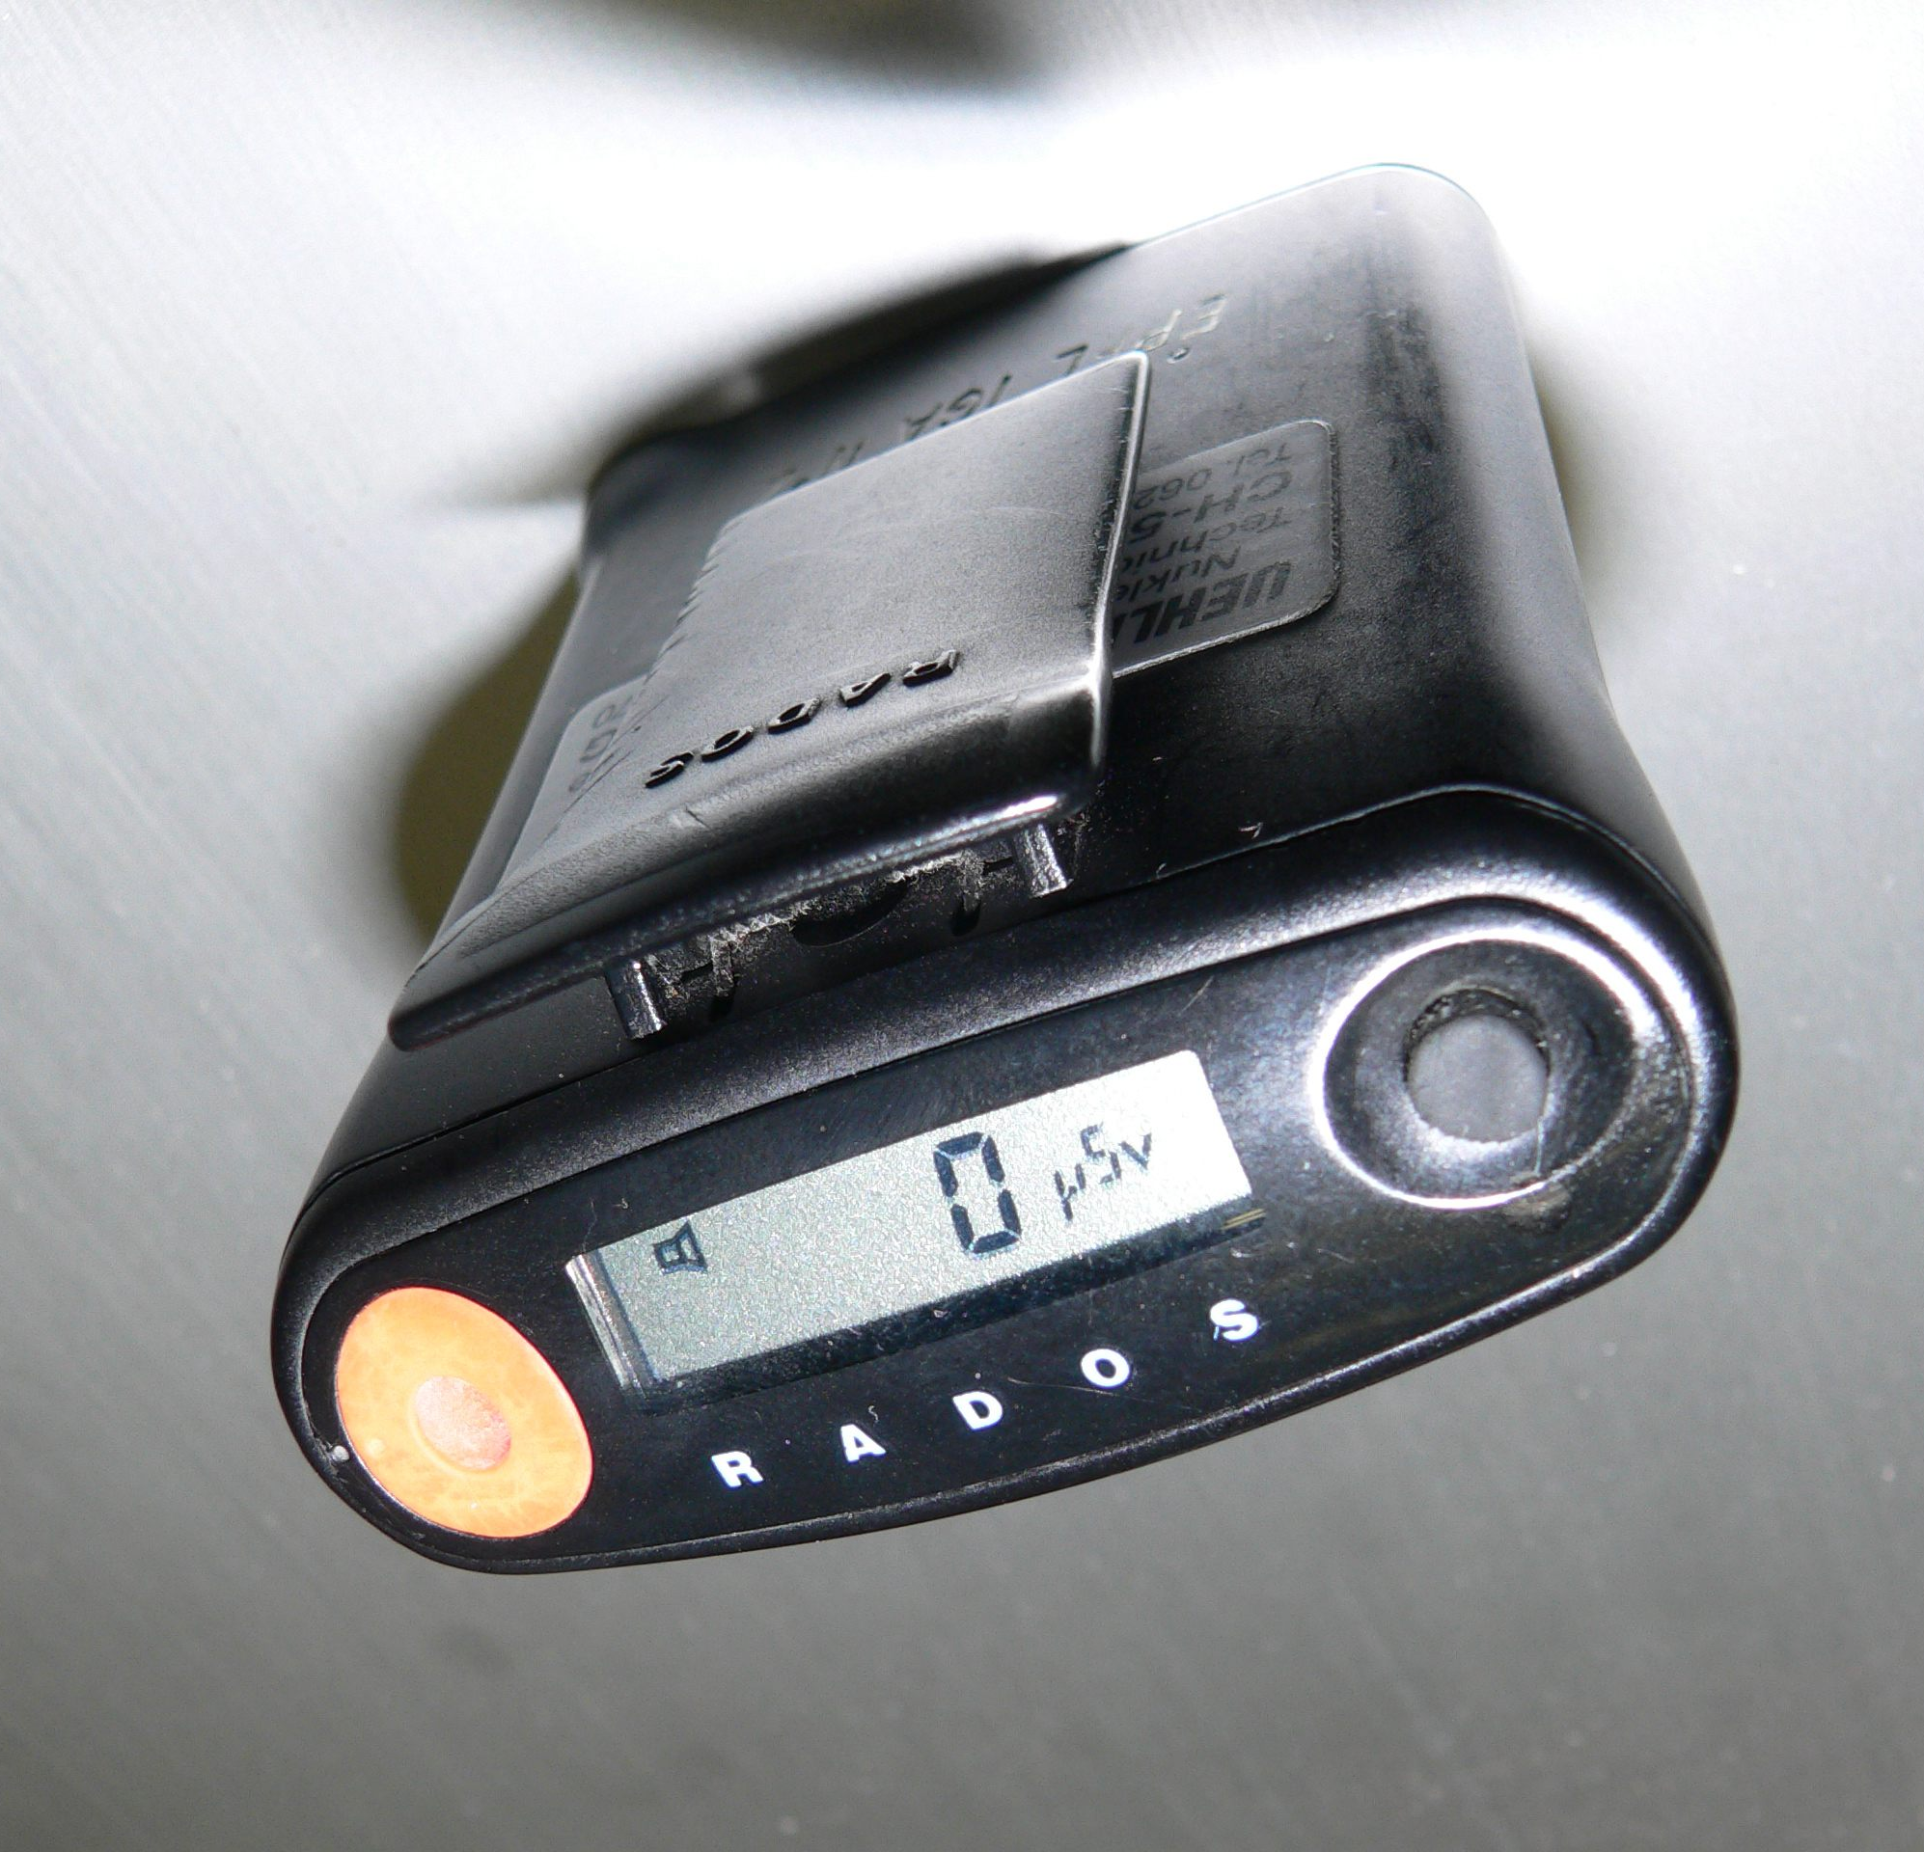
RADIATION MONITORING DEVICES
TLD
RING DOSIMETERS
ENVIRONMENTAL MONITORING DEVICES

Slide 32
DOSE LIMITS
Effective dose for occupational exposure is 20mSv per year averaged over 5 years
Effective dose for members of the public is 1 mSv per year
Hands of radiation workers: 500 mSv
Pregnant radiation worker?
Once a pregnancy is established, an annual effective dose equivalent to the mother of 15 mSv to protect the embryo/fetus.
250msv over a working lifetime for the effective dose

Slide 33
BASIC PRINCIPLES OF REDUCTION OF RADIATION DOSE
Applies to the radiation worker
3 basic principles
TIME
DISTANCE
SHIELDING

Slide 34
How does nuclear medicine differ from radiology?
Nuclear medicine uses a radioactive source that is injected, inhaled, eaten or drank by the patient. The patient then emits the gamma rays that are picked up by the SPECT or PET cameras that produces an image of the tracers distribution in the body.
Radiology uses radiation produced by the equipment eg, Xray machine, which passes through the body onto a detector or photographic film

Slide 35
PET/CT

Slide 36
SPECT/CT

Slide 37
Workflow in a radiopharmacy
Prescription from nuclear medicine physician (preferably 1 week earlier) →manufacture of radionuclide →labelling the radionuclide with the ligand →QC → manipulation of individual patients doses →labelling (patient’s name and hospital number, radiopharmaceutical identity, time) → shielding the syringe dose to NMT or Physician → take empty syringe and measure radioactivity inside → dispose empty syringe in a lead shielded waste container

Slide 38
QUESTIONS???

